Slide 1

Azure Purview #2
Unified data governance to maximize the business value of data
Michał Gołojuch, FastTrack Engineer
Situmalli Chandra Mohan, Senior FastTrack Engineer

Slide 2
- Business glossary - Data lineage - Metadata insights - Working with Atlas API - Integration with Azure Synapse - Sensitivity labels - QA
Agenda:

Slide 3
Azure Purview: Unified Data Governance
Azure Purview
Power BI
SQL Server on-prem
Azure Synapse
Azure Data Services
M365 Compliance Center
Unified Experience
Data Catalog
Data Insights
Search
Business Glossary
Lineage
Data use reports
Publish, Discover & Curate Data
Unified Platform
“Data Map” = Data Assets | Lineage | Classifications
Open APIs
Automated Scanning & Classification
(Apache Atlas 2.0)
On-prem & Multicloud Operational, Analytical, SaaS
Notes:
Maximize business value of data with Azure Purview, a unified data governance solution, across operational and transactional data. Enable business and technical analysts to find, interpret and trust data with an intuitive catalog. Get insights and ensure data usage is governed within compliance guardrails.
Azure Purview is a unified data governance service. It organizes vast metadata that enables organizations to break down silos and derive meaning from data. Once data can be understood and annotated, it then lends itself to several applications – the first of which, we announced at public preview, being data catalog and data insights. In the future, privacy, quality and master data management value will follow.

Slide 4

Azure Purview - Demo

Slide 5
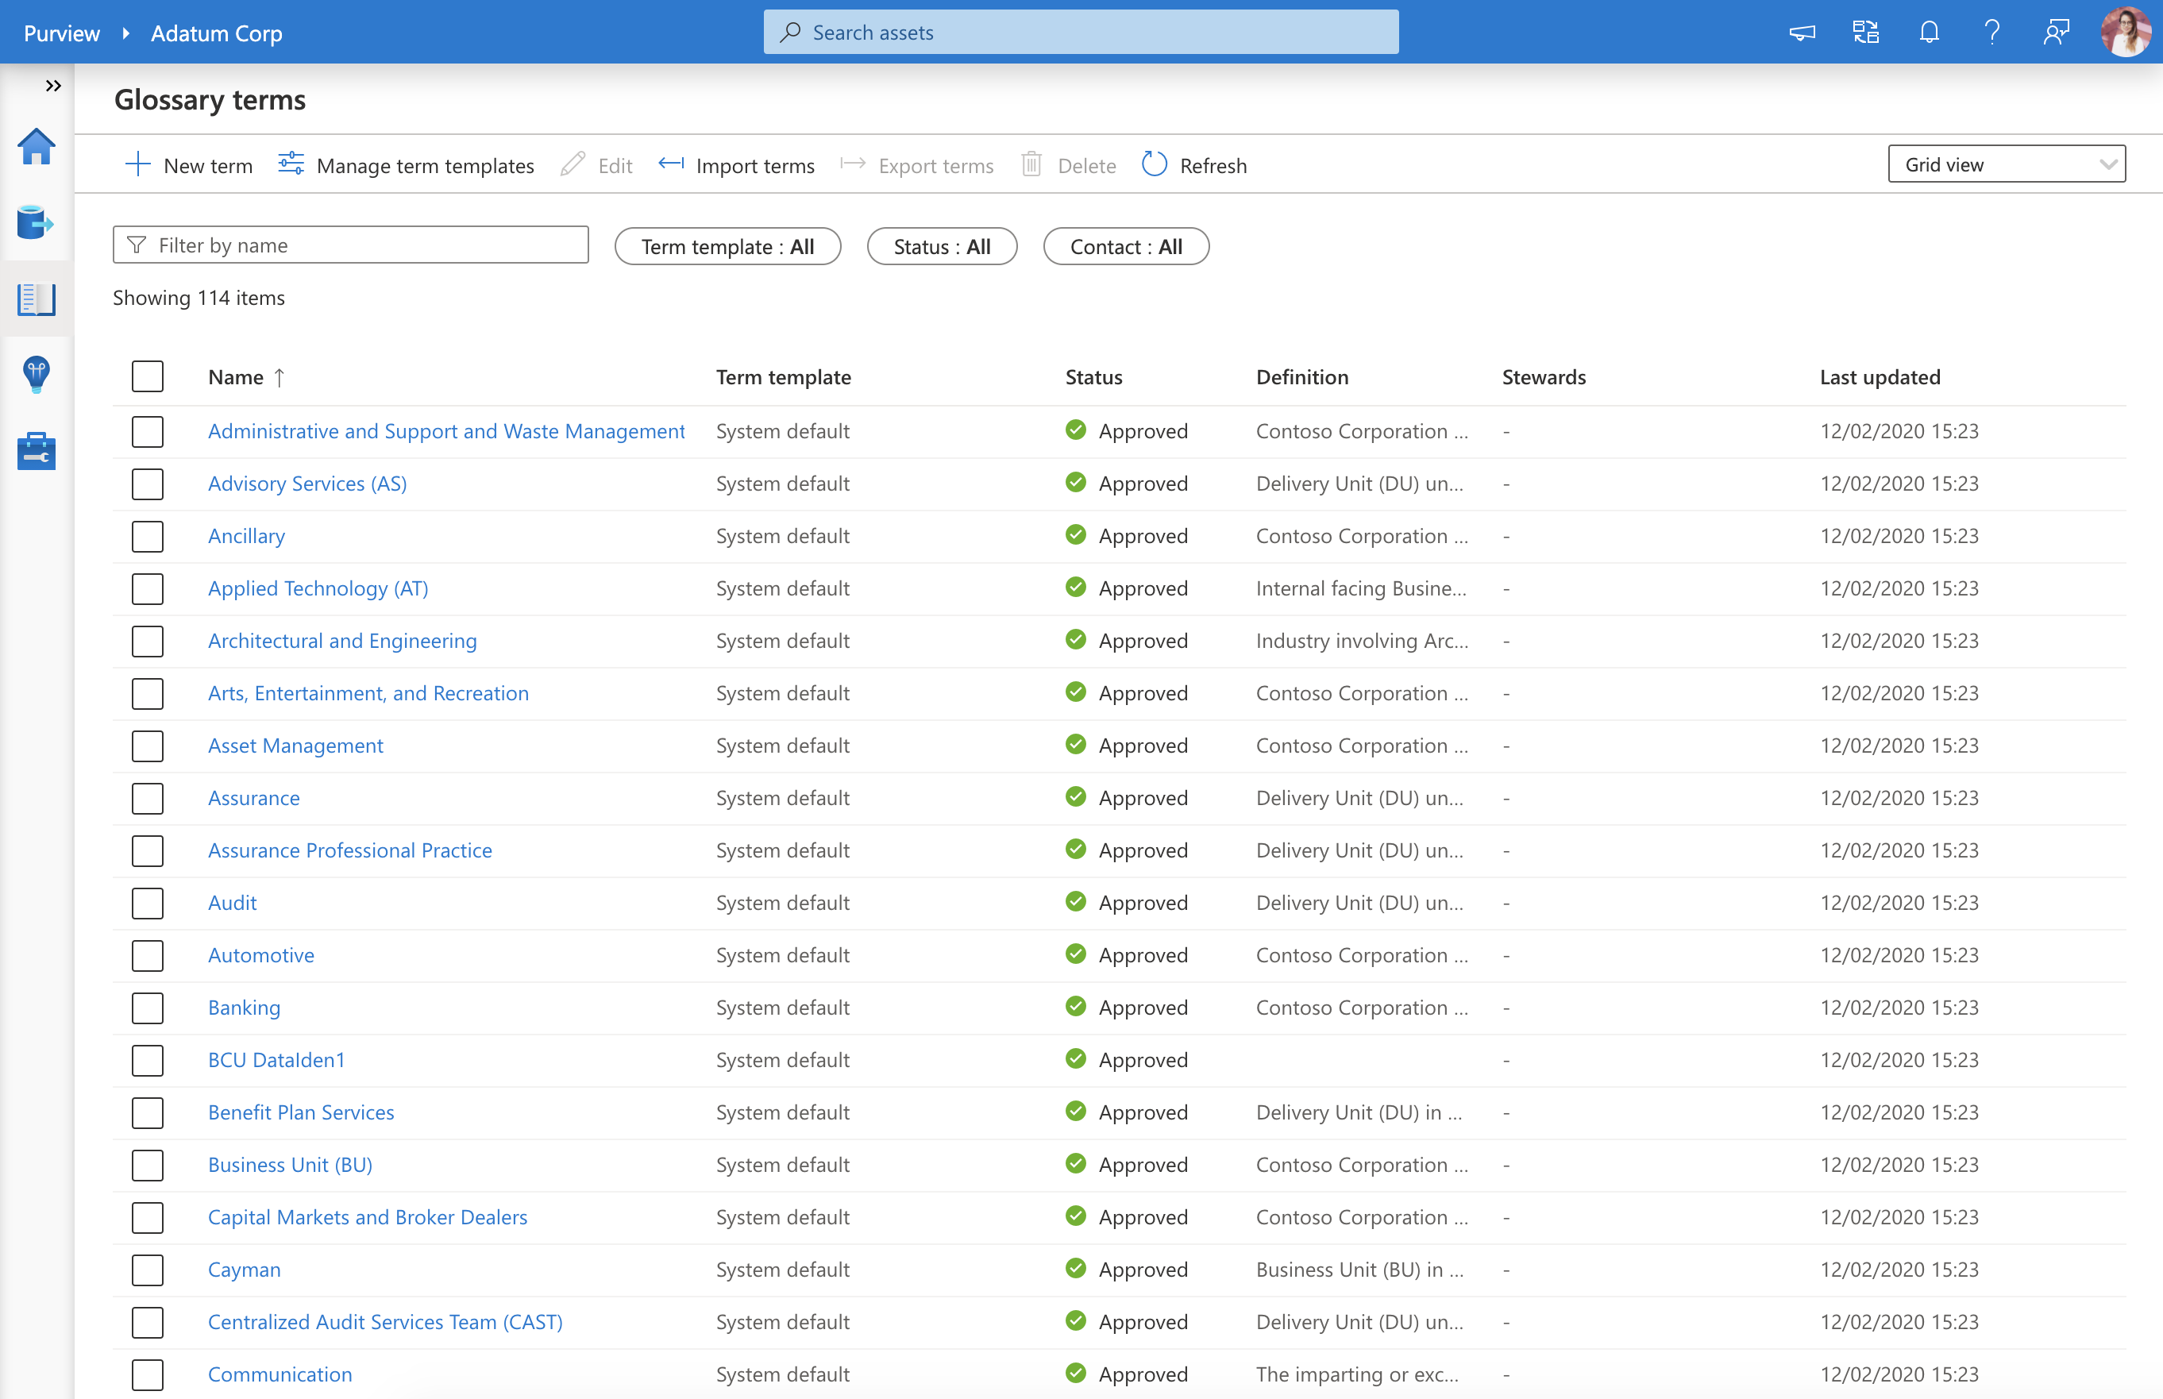
Azure Purview> Studio > Business Glossary
Business Glossary
Consistent and curated understanding of business terms and definitions
Benefits
Understand business context associated with data in the organization
Bulk Import glossary terms from existing data dictionaries easily
Flexible business terms definition with custom attributes per business domain
Browse & Search your data estate from a business lens

Slide 6
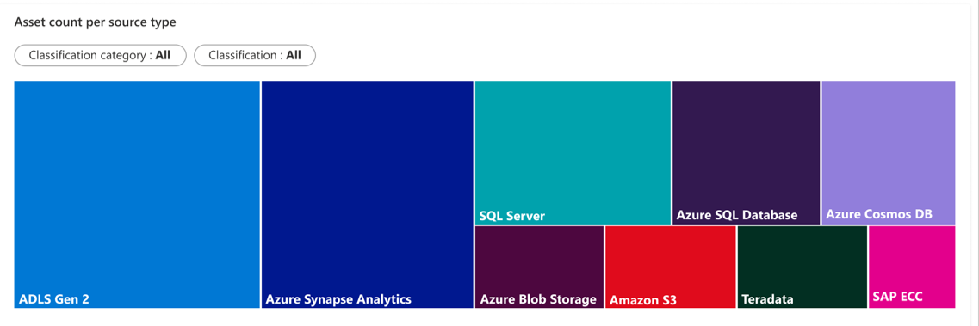
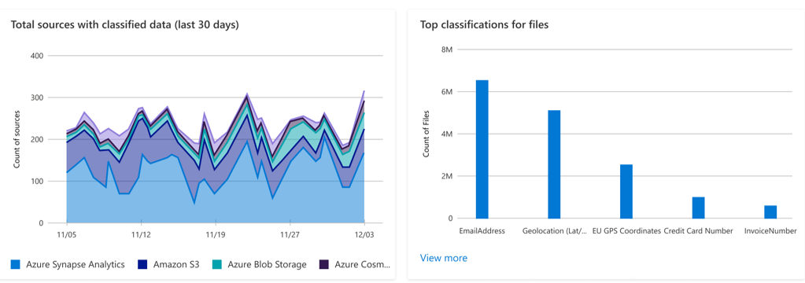
Azure Purview> Studio > Insights
Data Insights
Bird’s eye view of data landscape
Benefits
Intended to help users such as Chief Data Officers quickly understand their data estate at large and gain key insights such as where sensitive data resides
Asset Insights to see where all data resides across a range of data sources. Scan Insights to track successful, failed, cancelled scans over a period. Glossary insights to understand changes made to business terms and how much coverage glossary has over your data map
Sensitive data Insights to simplify compliance risk assessment across operational and transactional data sources. Assess risk and derive audit trails of data qualified by sensitivity and business relevance
Notes:
Azure Purview Insights offers a wealth of information to help you understand, catalog, govern, and secure your data. From the panoramic view across your data of Asset Insights to in-depth view to act on specific assets to understanding the sensitivity of data with Classification Insights and Sensitivity Labels. Insights is your one-stop shop to managing across the breadth of your company’s data estate.

Slide 7

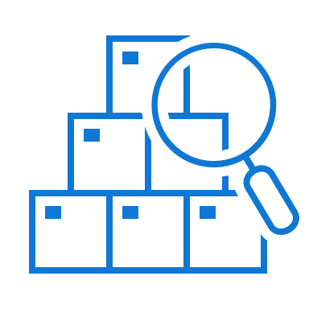
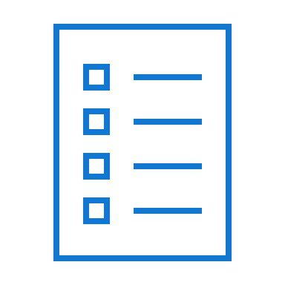
Synapse + Purview: Better Together
Register
Register Synapse workspaces with Purview
Browse & Search
Search datasets in Synapse workspaces from linked Purview catalog
Enhanced metadata, lineage and annotation
View enhanced metadata, lineage from Purview for Synapse tables and add annotations

Slide 8
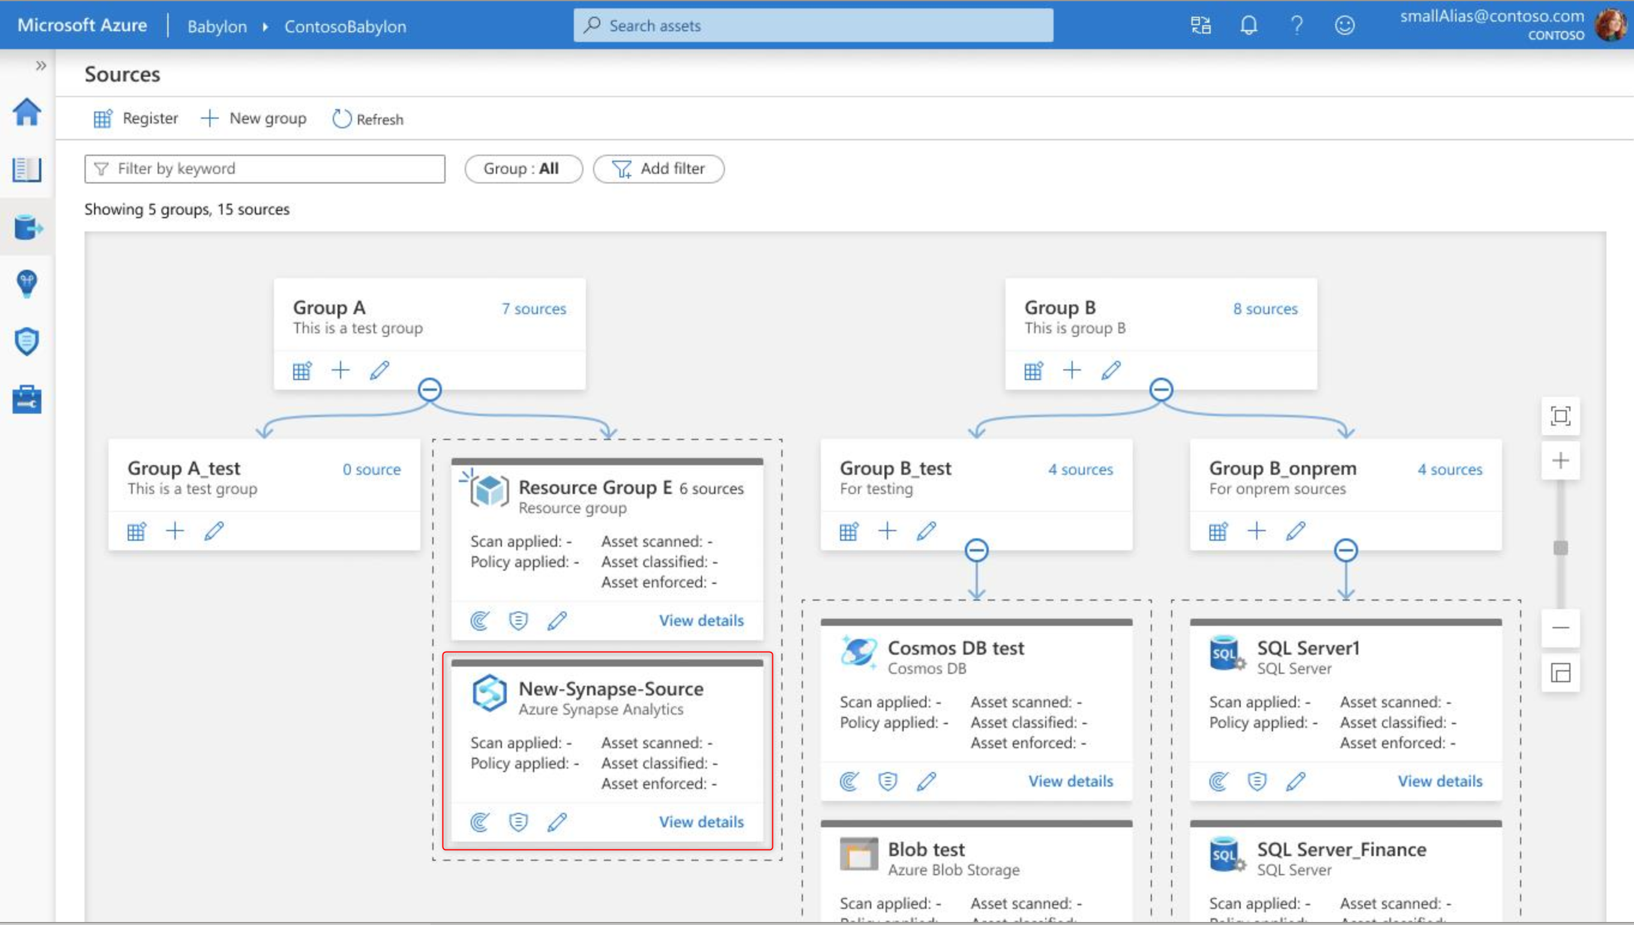
Register Synapse Workspaces

Slide 9
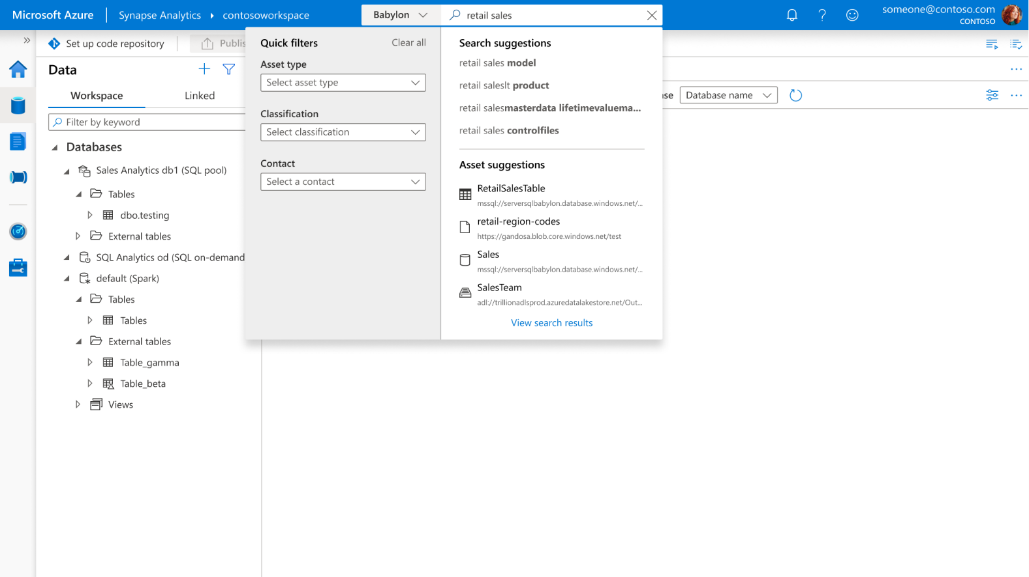
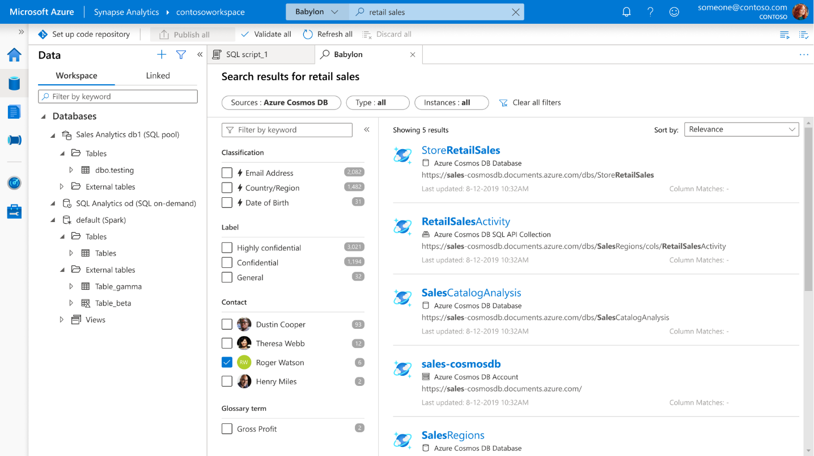

Browse & Search: Synapse (powered by Purview)

Slide 10
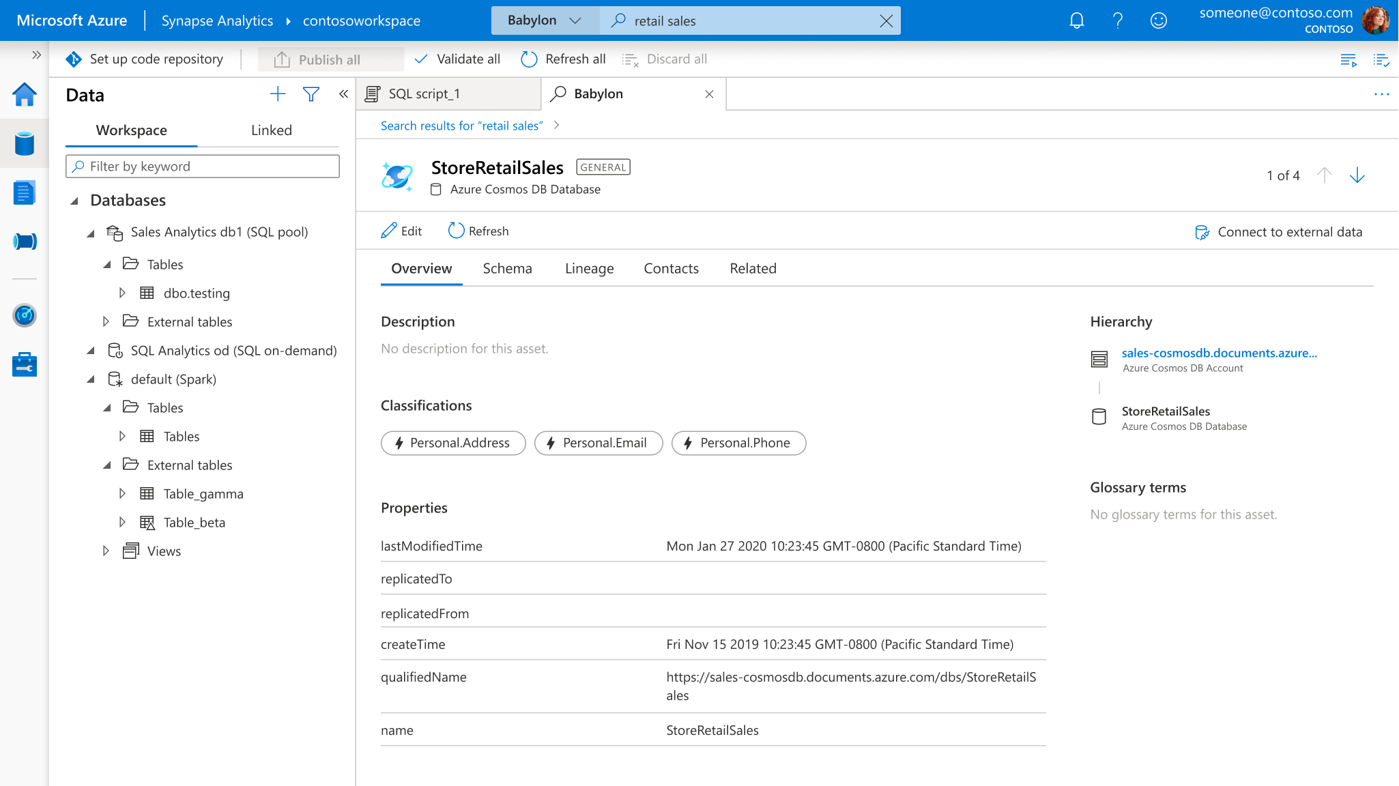
Enhanced Metadata, Lineage & Annotation
Purview

Slide 11
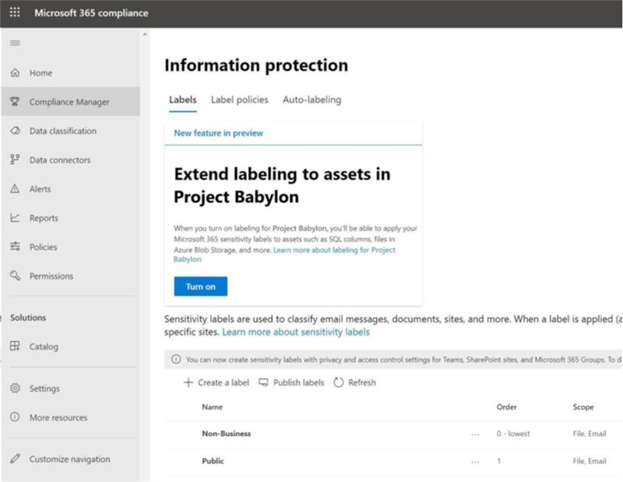
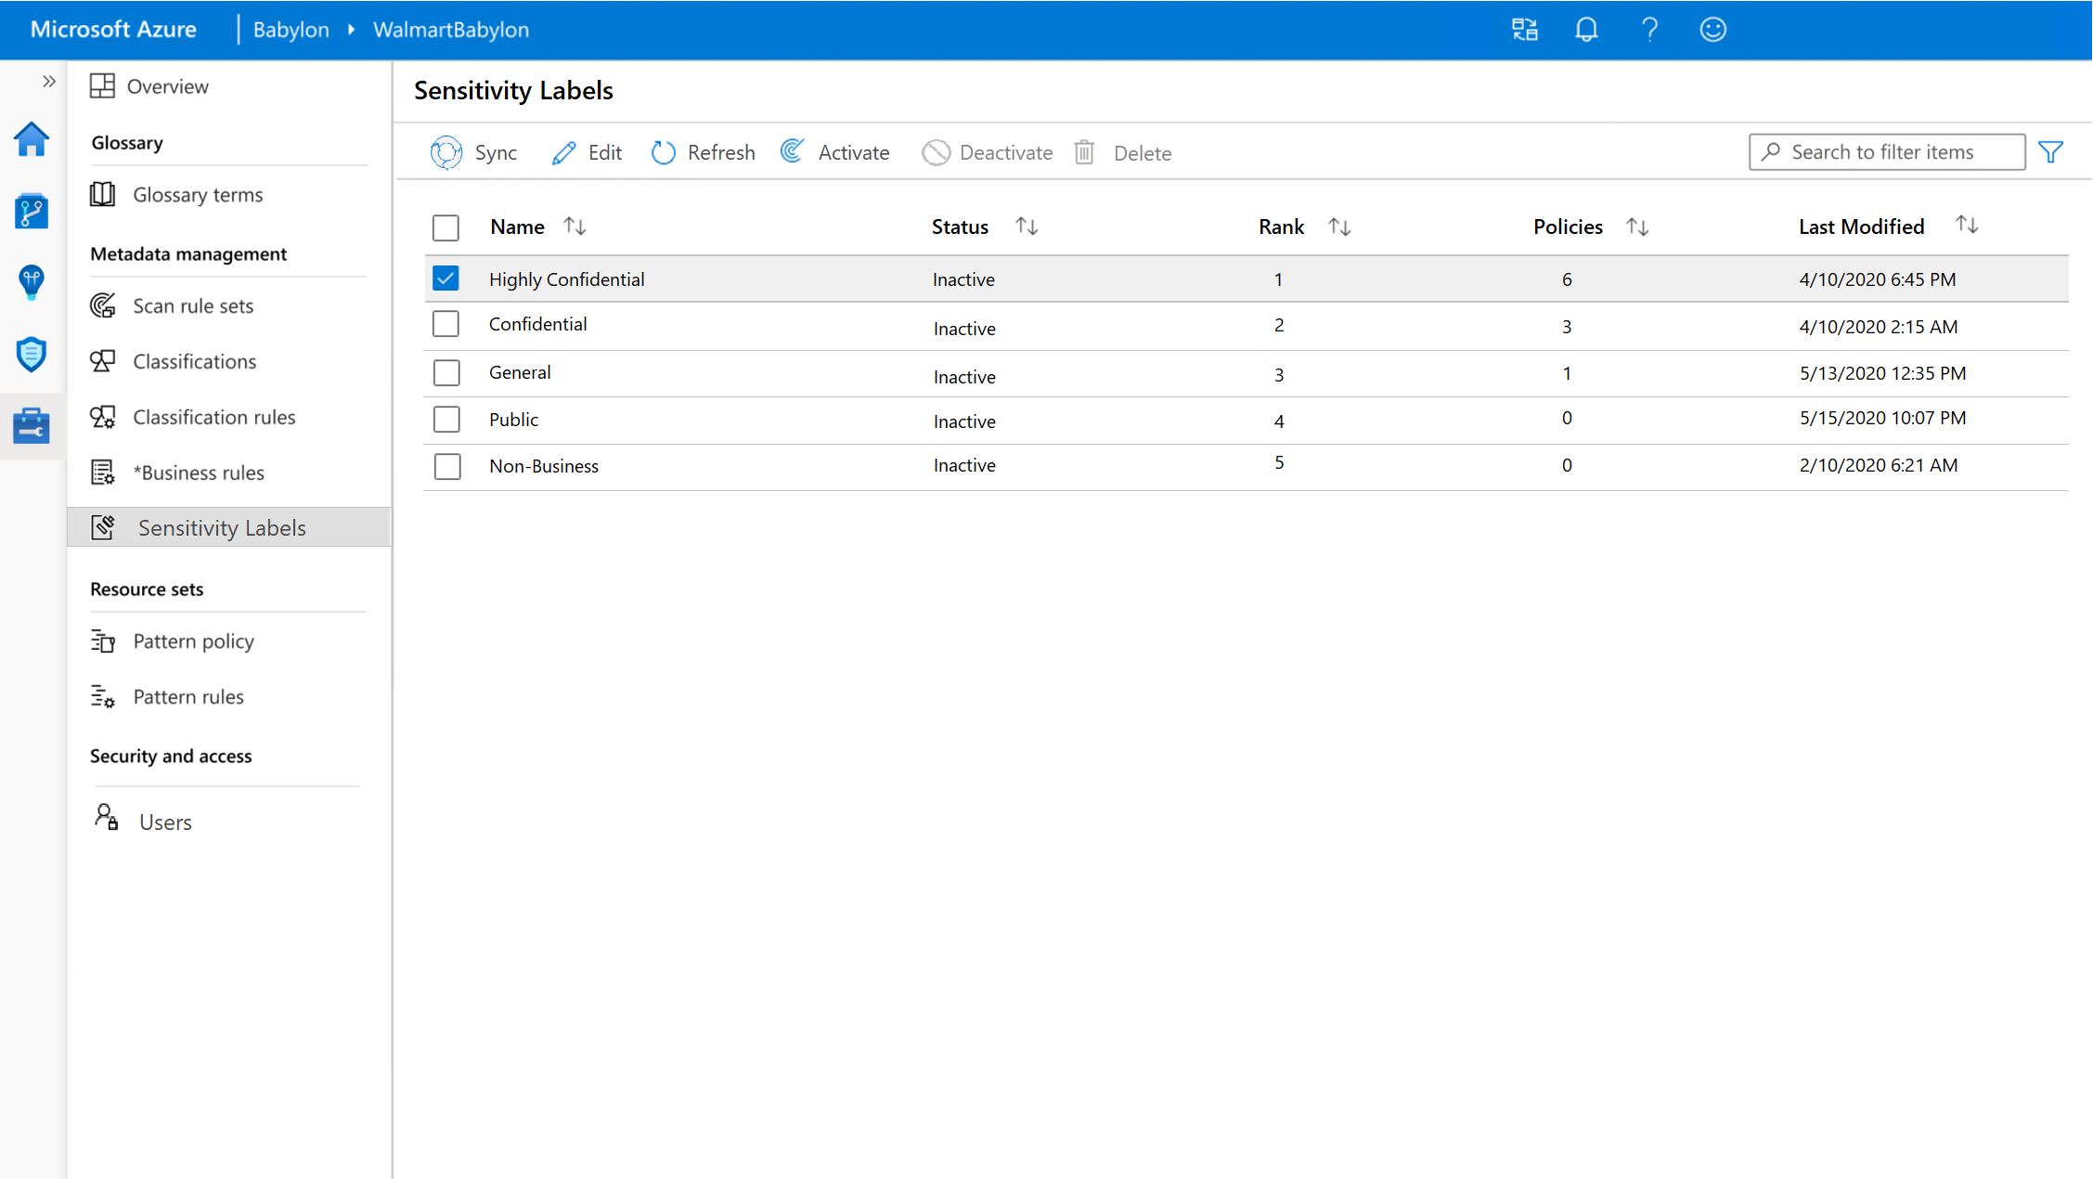
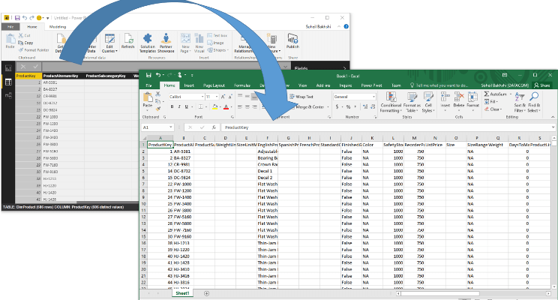
Microsoft 365 + Purview: Better Together
Scenario
Consistent classification and Labels across M365, Azure, SQL Svr, Power BI
Extend labelling to assets in Azure Purview
Discover Purview from M365 Compliance Center & get started with classifiers and labels
Classification & Labels applied across breadth of Data Estate by Purview
Information worker exports data from Power BI & saves to Excel with same sensitivity label
M365 -> Azure -> PBI -> M365
Auto labelling
Labels automatically cascade via lineage

